Slide 1
MASTERS IN PROJECT MANAGEMENT
PROJECT RISK
MANAGEMENT
Class: MS(PM)-2(A,B&C)

Slide 2
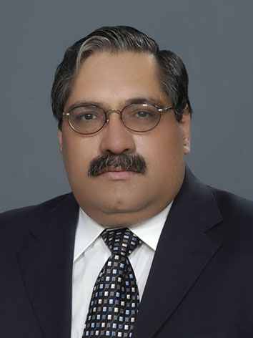
Instructor
Suhail Iqbal
PE, PMP, PgMP, PME, MCT, PRINCE2 Practitioner.
PE, PMP, PgMP, PME, MCT, PRINCE2 Practitioner.
Notes:
Custom animation effects: horizontal scrolling text
(Basic)
To reproduce the text effects on this slide, do the following:
On the Home tab, in the Slides group, click Layout, and then click Blank.
On the Insert tab, in the Text group, click Text Box, and then on the slide, drag to draw the text box.
Enter text in the text box. (Note: You may want to add a bullet point at the end of your text, as in the example above. On the Insert tab, in the Text group, click Symbol. In the Symbol dialog box, in the Font list, select (normal text). In the Subset list, select General Punctuation. In the Character Code box, enter 2022 to select BULLET, and then click Insert.)
Select the text. On the Home tab, in the Font group, do the following:
In the Font list, select Gill Sans MT.
In the Font Size list, select 36.
Click Bold.
Click the arrow next to Font Color, and then under Theme Colors click White, Background 1 (first row, first option from the left).
On the Home tab, in the Paragraph group, click Align Text Left to align the text left in the text box. (Note: If the text wraps to more than one line, drag the adjustment handles on the text box to widen it until the text fits on one line.)
Drag the text box to the left of the lower left edge of the slide. (Note: To see beyond the edges of the slide, on the View tab, click Zoom, and then in the Zoom dialog box, in the Percent box, enter 40%.)
To reproduce the animation effects on this slide, do the following:
On the Animations tab, in the Animations group, click Custom Animation.
On the slide, select the text box. In the Custom Animation task pane, do the following:
Click Add Effect, point to Entrance, and then click More Effects. In the Add Entrance Effect dialog box, under Basic, click Fly In.
Select the animation effect (fly-in effect for the text box). Click the arrow to the right of the select effect, and then click Effect Options. In the Fly In dialog box, do the following:
On the Effect tab, in the Direction list, select From Right.
On the Timing tab, do the following:
In the Start list, select With Previous.
In the Speed box, enter 16 seconds.
In the Repeat list, select Until End of Slide.
On the slide, select the text box. On the Home tab, in the Clipboard group, click the arrow under Paste, and then click Duplicate.
In the Custom Animation task pane, select the second animation effect (fly-in effect for the second text box). Click the arrow to the right of the selected effect, and then click Timing. In the Fly In dialog box, on the Timing tab, in the Delay box, enter 8. (Note: You may need to adjust the delay time if the length of your text is different than the example above.)
On the slide, drag the second text box on top of the first text box.
On the Home tab, in the Editing group, click Select, and then click Selection Pane.
In the Selection and Visibility pane, press and hold CTRL, and then select both text boxes. On the Home tab, in the Drawing group, click Arrange, point to Align, and then do the following:
Click Align Selected Objects.
Click Align Middle.
Click Align Center.
To reproduce the background effects on this slide, do the following:
Right-click the slide background area, and then click Format Background. In the Format Background dialog box, click Fill in the left pane, and then select Picture or texture fill in the Fill pane. Under Insert from, click File. In the Insert Picture dialog box, select a picture, and then click Insert.
On the Home tab, in the Drawing group, click Shapes, and then under Rectangles click Rectangle (first option from the left). On the slide, drag to draw a rectangle.
Select the rectangle. Under Drawing Tools, on the Format tab, in the Size group, do the following:
In the Shape Height box, enter 7.5”.
In the Shape Width box, enter 1”.
Under Drawing Tools, on the Format tab, in the Shape Styles group, click the arrow next to Shape Outline, and then click No Outline.
On the Home Tab, in the Drawing group, click the arrow next to Shape Fill, point to Gradient, and then click More Gradients. In the Format Shape dialog box, click Fill in the left pane, select Gradient fill in the Fill pane, and then do the following:
In the Type list, select Linear.
Click the button next to Direction, and then click Linear Right (first row, fourth option from the left).
Under Gradient stops, click Add or Remove until two stops appear in the drop-down list.
Also under Gradient stops, customize the gradient stops that you added as follows:
Select Stop 1 from the list, and then do the following:
In the Stop position box, enter 0%.
Click the button next to Color, and then under Theme Colors click Black, Text 1 (first row, second option from the left).
In the Transparency box, enter 0%.
Select Stop 2 from the list, and then do the following:
In the Stop position box, enter 100%.
Click the button next to Color, and then under Theme Colors click Black, Text 1, (first row, second option from the left).
In the Transparency box, enter 100%.
On the slide, select the rectangle. On the Home tab, in the Drawing group, click Arrange, point to Align, and then do the following:
Click Align to Slide.
Click Align Left.
Click Align Middle.
Select the rectangle. On the Home tab, in the Clipboard group, click the arrow under Paste, and then click Duplicate.
Select the duplicate rectangle. On the Home Tab, in the Drawing group, click the arrow next to Shape Fill, point to Gradient, and then click Linear Left (second row, third option from the left).
With the duplicate rectangle still selected, on the Home tab, in the Drawing group, click Arrange, point to Align, and then do the following:
Click Align to Slide.
Click Align Right.
Click Align Middle.

Slide 3
SYLLABUS
Unit | Content | Learning Objectives
Change Management in Projects and It's Linkage to Risk Management | Change Management Projects, Programs and Portfolios Project Management Project Management Office Uncertainty and Risk Managing Change during Projects Impact of Change on Risk Management | Understand the concept of how change affects an organization and a project and how risks are directly impacted by change in projects.

Slide 4
UNIT 2
UNIT 2
OVERVIEW
Change Management in Projects and It's Linkage to Risk Management
PROJECT RISK
MANAGEMENT
Class: MS(PM)-2 (A,B&C)

Slide 5
OVERVIEW
CONTENT
UNIT 2
Change Management
Projects, Programs and Portfolios
Project Management
Project Management Office
Uncertainty and Risk
Managing Change during Projects
Impact of Change on Risk Management

Slide 6
CHANGE MANAGEMENT
UNIT 2
Change management is a structured approach to transitioning individuals, teams, and organizations from a current state to a desired future state.
In project management, change management refers to a project management process where changes to a project are formally introduced and approved.
The field of change management grew from the recognition that organizations are composed of people. And the behaviors of people make up the outputs of an organization.
From Wikipedia, the free encyclopedia

Slide 7
CHANGE MANAGEMENT
UNIT 2
Organizations are starting to realize that change is now a normal and inevitable part of organizational life if they are to survive and grow.
Nevertheless, the failure rate for introducing change is high.
Instead of providing the gains promised, these changes create confusion, disillusionment and low morale resulting in low productivity.
From http://www.cmdevelopment.co.uk

Slide 8
Responsibility for Change
UNIT 2
The employee does not have a responsibility to manage change
Responsibility for managing change is with management and executives of the organization
The manager has a responsibility to facilitate and enable change
The manager's role is to interpret, communicate and enable - not to instruct and impose, which nobody really responds to well.
change must involve the people - change must not be imposed upon the people

Slide 9
Change - Key Roles
UNIT 2
Sponsors - legitimize the change.
Change Agents - planning and executing the change project.
Targets - must alter the way they work as a result of the change.
Advocates - who would like to see a change project idea happen.

Slide 10
Change Management Principles
UNIT 2
At all times involve and agree support from people within system (system = environment, processes, culture, relationships, behaviours, etc., whether personal or organisational).
Understand where you/the organisation is at the moment.
Understand where you want to be, when, why, and what the measures will be for having got there.
Plan development towards above No.3 in appropriate achievable measurable stages.
Communicate, involve, enable and facilitate involvement from people, as early and openly and as fully as is possible.

Slide 11
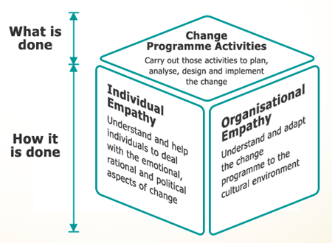
Successful Change Management

Slide 12
Change Management Steps
UNIT 2
Increase urgency
Build the guiding team
Get the vision right
Communicate for buy-in
Empower action
Create short-term wins
Don't let up
Make change stick
From American John P Kotter (b 1947), a Harvard Business School professor
Notes:
Increase urgency - inspire people to move, make objectives real and relevant.
Build the guiding team - get the right people in place with the right emotional commitment, and the right mix of skills and levels.
Get the vision right - get the team to establish a simple vision and strategy, focus on emotional and creative aspects necessary to drive service and efficiency.
Communicate for buy-in - Involve as many people as possible, communicate the essentials, simply, and to appeal and respond to people's needs. De-clutter communications - make technology work for you rather than against.
Empower action - Remove obstacles, enable constructive feedback and lots of support from leaders - reward and recognise progress and achievements.
Create short-term wins - Set aims that are easy to achieve - in bite-size chunks. Manageable numbers of initiatives. Finish current stages before starting new ones.
Don't let up - Foster and encourage determination and persistence - ongoing change - encourage ongoing progress reporting - highlight achieved and future milestones.
Make change stick - Reinforce the value of successful change via recruitment, promotion, new change leaders. Weave change into culture.

Slide 13
Change Management Phases
UNIT 2
Creating Conditions for Change
Making Change Happen
Making Change Stick

Slide 14
Phase 1: Creating Conditions for Change
UNIT 2
Develop Political Acumen.
Create a Guiding Coalition.
Develop a Vision and Strategy—Focus Your Thinking.
Communicate That Change Vision—Tell the Tale.

Slide 15
Phase 2: Making Change Happen
UNIT 2
Generate Short-Term Wins.
Develop Broad-Based Action.
Consolidate Gains and Produce More Change.
Structures
Skills
Systems
Supervisors

Slide 16
Phase 3: Making Change Stick
UNIT 2
The teamwork and cross-organization cooperation
Culture change

Slide 17
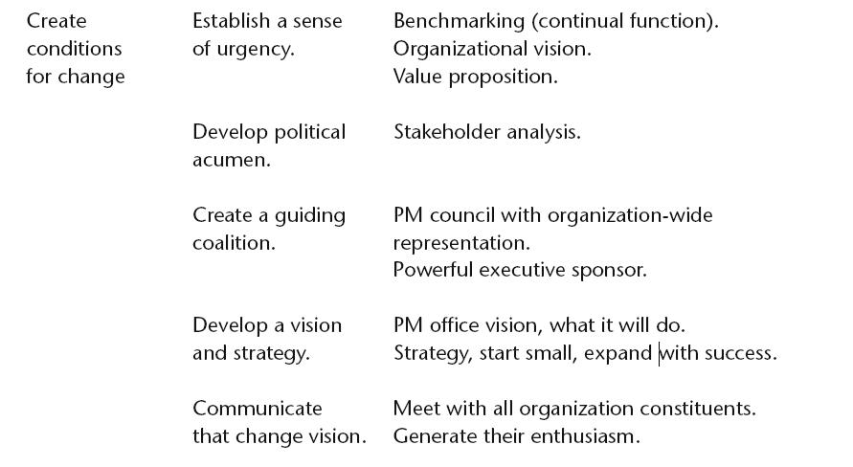

Slide 18
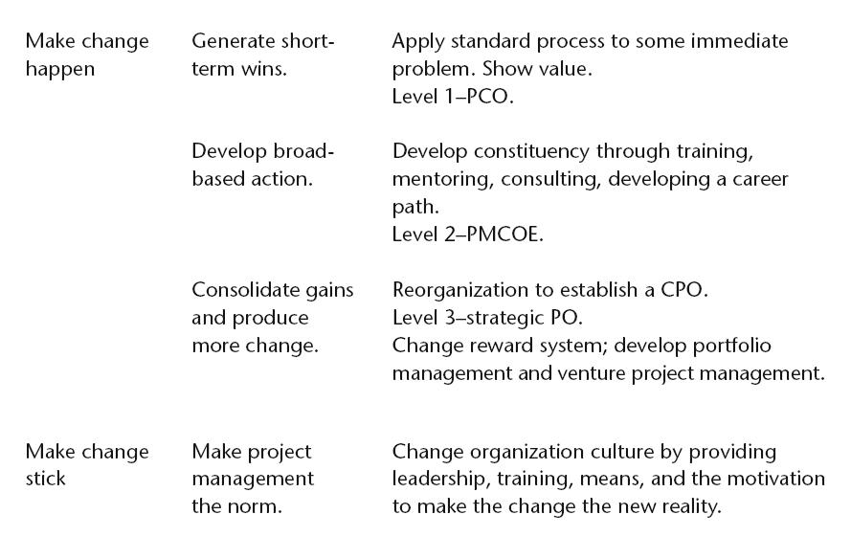

Slide 19
Developing a Value Proposition
UNIT 2
Achieving Strategy.
Increasing Return on Investment.
Building Competitive Advantage.
Creating New Products.
Increasing Sales.
Decreasing Costs.
Exploiting Unanticipated Capabilities.
Evolving Toward Self-Funding.

Slide 20
PROJECTS, PROGRAMS AND PORTFOLIOS
UNIT 2
Project
Project Management
Program
Program Management
Portfolio
Portfolio Management
Project Management Office (PMO)
Organizational Project Management Maturity (OPM3)
From Wikipedia, the free encyclopedia

Slide 21
What is a Project?
Topic 1.2
PROJECT
A project is a temporary endeavor undertaken to create a unique product, service or result.
A Guide to Project Management Body of Knowledge (PMBOK®), Fourth Edition

Slide 22
Project Manager
Stakeholders
Topic 2.3
PROJECT MANAGERS
Project managers are assigned by the performing organization to achieve project objectives.
This is a challenging, high-profile role with significant responsibility and shifting priorities.
It requires
flexibility,
good judgment,
strong leadership and negotiation skills, and
a solid knowledge of project management practices.
A project manager must be able to understand project detail, but manage from the overall project perspective.
A Guide to Project Management Body of Knowledge (PMBOK®), Fourth Edition

Slide 23
Program Management
Topic 1.4.2
PROGRAM
A program is a group of related projects managed in a coordinated way to obtain benefits and control not available from managing them individually.
Programs may include elements of related work outside of the scope of the discrete projects in the program.
A project may or may not be part of a program but a program will always have projects.
A Guide to Project Management Body of Knowledge (PMBOK®), Fourth Edition

Slide 24
Program Management
Topic 1.4.2
PrOGRAM Management
Program Management is defined as the centralized coordinated management of a program to achieve the program’s strategic objectives and benefits.
Projects within a program are related through the common outcome and collective capability.
Focuses on project interdependencies and helps to determine the optimal approach for managing them.
Following relationships qualify for portfolio management and not program management:
Shared client, Seller, Technology, and Resource.
A Guide to Project Management Body of Knowledge (PMBOK®), Fourth Edition

Slide 25
Program Management
Topic 1.4.2
Project interdependencieS
Actions related to project interdependencies may include:
Resolving resource constraints and/or conflicts that affect multiple projects within the system.
Aligning organizational/strategic direction that affects project and program goals and objectives.
Resolving issues and change management within a shared governance structure.
A Guide to Project Management Body of Knowledge (PMBOK®), Fourth Edition

Slide 26
Portfolio Management
Topic 1.4.1
PORTFOLIO
A portfolio is a collection of projects or programs and other work that are grouped together to facilitate effective management of that work to meet strategic business objectives.
The projects or programs in the portfolio may not necessarily be interdependent or directly related.
A Guide to Project Management Body of Knowledge (PMBOK®), Fourth Edition

Slide 27
Portfolio Management
Topic 1.4.1
PORTFOLIO Management
Portfolio Management refers to the centralized management of one or more portfolios, which includes identifying, prioritizing, managing, and controlling projects, programs, and other related work, to achieve specific strategic business objectives.
Portfolio Management focuses on ensuring that projects and programs are reviewed to prioritize resource allocation, and that the management of the portfolio is consistent with and aligned to organizational strategies.
A Guide to Project Management Body of Knowledge (PMBOK®), Fourth Edition

Slide 28
Project Management Office
Topic 1.4.4
PMO
A Project Management Office (PMO) is an organizational body or entity assigned various responsibilities related to the centralized and coordinated management of those projects under its domain.
The responsibilities of a PMO can range from providing project management support functions to actually being responsible for the direct management of a project.
The projects supported or administered by the PMO may not be related other than by being managed together.
Specific form, function, and structure of a PMO is dependent upon the supported organization’s needs.
A Guide to Project Management Body of Knowledge (PMBOK®), Fourth Edition

Slide 29
Project Management Office
Topic 1.4.4
PMO
A PMO can be delegated authority to act as an integral stakeholder and a key decision maker during the beginning of each project, to make recommendations, or to terminate projects or take other actions as required to keep business objectives consistent.
A PMO may be involved in selection, management, and deployment of shared or dedicated project resources.
A Guide to Project Management Body of Knowledge (PMBOK®), Fourth Edition

Slide 30
Project Management Office
Topic 1.4.4
Primary FUnction of a PMO
A primary function of a PMO is to support project managers in a variety of way which may include, but are not limited to:
Managing shared resources across all projects administered by the PMO.
Identifying and developing project management methodology, best practices, and standards.
Coaching, mentoring, training, and oversight.
Monitoring compliance with project management standards, policies, procedures, and templates via project audits.
Developing and managing project policies, procedures, templates, and other shared documentation.
Coordinating communication across projects.
A Guide to Project Management Body of Knowledge (PMBOK®), Fourth Edition

Slide 31
PMO
Stakeholders
Topic 2.3
PMO PROVIDES
The PMO can provide but is not limited to:-
Administrative support services such as policies, methodologies, and templates.
Training, mentoring, and coaching of project managers.
Project support, guidance, and training on how to manage projects and the use of tools.
Resource alignment of project staff.
Centralized communication among project managers, project sponsors, managers, and other stakeholders.
A Guide to Project Management Body of Knowledge (PMBOK®), Fourth Edition

Slide 32
UNCERTAINTY AND RISK
UNIT 2
The future always brings surprises.
Sometimes, the surprises are nice, but often they are unpleasant.
Many people want ways to protect themselves from the unpleasant surprises.
They are willing to pay for protection against risk and uncertainty.
From http://ingrimayne.com/econ/RiskExclusion/Speculators.html

Slide 33
UNCERTAINTY AND RISK
UNIT 2
Frank H. Knight's (1921: p.20, Ch.7) interpretation:
"risk" refers to situations where the decision-maker can assign mathematical probabilities to the randomness which he is faced with.
"uncertainty" refers to situations when this randomness "cannot" be expressed in terms of specific mathematical probabilities.
From http://ingrimayne.com/econ/RiskExclusion/Speculators.html

Slide 34
MANAGING CHANGE DURING PROJECTS
UNIT 2
Never Say No To a Client
Change is Bad
Saying Yes leads to Change
Change leads to Lack of Control
Lack of control leads to Suffering
Change is Good
Saying Yes leads to Change
Change leads to More Work
More Work leads to Happiness (Increased Project Revenue and Gross Profit)
Balance - a Neat Trick
Balancing between stonewalling and accepting all proposed changes and causing major project control problems.
“Your request makes sense, but it raises potential risks and issues that might cost time and money.”
From http://www.evolt.org/change-requests

Slide 35
IMPACT OF CHANGE ON RISK MANAGEMENT
UNIT 2
High-risk activities increasingly occur beyond the boundaries where traditional control environments operate
These changes will tear up the rule book in the way successful enterprises think about and govern risks.
Compliance with ISO27001, ITIL or adherence to Cobit standards within the IT function may no longer alone be sufficient to govern risks over IT services, if they ever were.
From Wikipedia, the free encyclopedia

Slide 36
IMPACT OF CHANGE ON RISK MANAGEMENT
UNIT 2
Rapidly increasing volumes of data by outsourcing data management to third parties - Risk of control being exercised over data handling being performed by these third parties.
Joint ventures and partnerships - the need to share and disseminate commercially sensitive data is also increasing
People's interaction with technology - Outside work is an area not often considered on risk registers
Huge volumes of data ranging from customer purchasing habits, to transaction tracking logs have been building up within corporate systems for years - over the next decade we are going to see an explosion both the ability and the opportunities for enterprises to exploit this data.
From http://www.computerweekly.com

Slide 37
UNIT 2
Review Questions

Slide 38
The End
THE END
THANK YOU

